Slide 1


COST OF LIVING DASHBOARD
VISUALIZATION TOOL : POWERBI
PRESENTED BY : MARIAM OPEYEMI MOJEED

Slide 2
OVERVIEW
ABSTRACT
PROBLEM STATEMENT
COST OF LIVING
APPRECIATION
CORRELATION
INSIGHTS
APPRECIATION

Slide 3
This project revolves around the analysis of the cost of living in various cities and countries across the globe. The dataset used for this analysis encompasses a wide range of economic indicators, from the price of basic commodities to the cost of housing, transportation, and even entertainment.
By harnessing the power of Power BI, we aim to gain valuable insights into the economic disparities between different regions and understand the factors that contribute to the varying costs of living. This project serves as an exercise in data visualization, analysis, and interpretation, offering a comprehensive view of the world's economic landscape.
ABSTRACT

Slide 4
The cost of living is a crucial metric that impacts individuals and businesses alike. Understanding the cost
of living in different cities and countries is vital for making informed decisions regarding relocation,
investment, or business expansion. This project aims to address several key questions:
• What are the cities and countries with the highest and lowest costs of living?
• What are the major cost components contributing to the overall cost of living in a region?
• How do factors like average salary, housing costs, and transportation expenses correlate with the
cost of living?
• Are there any trends or patterns in the data that can help individuals and organizations make
strategic decisions?
PROBLEM STATEMENT

Slide 5
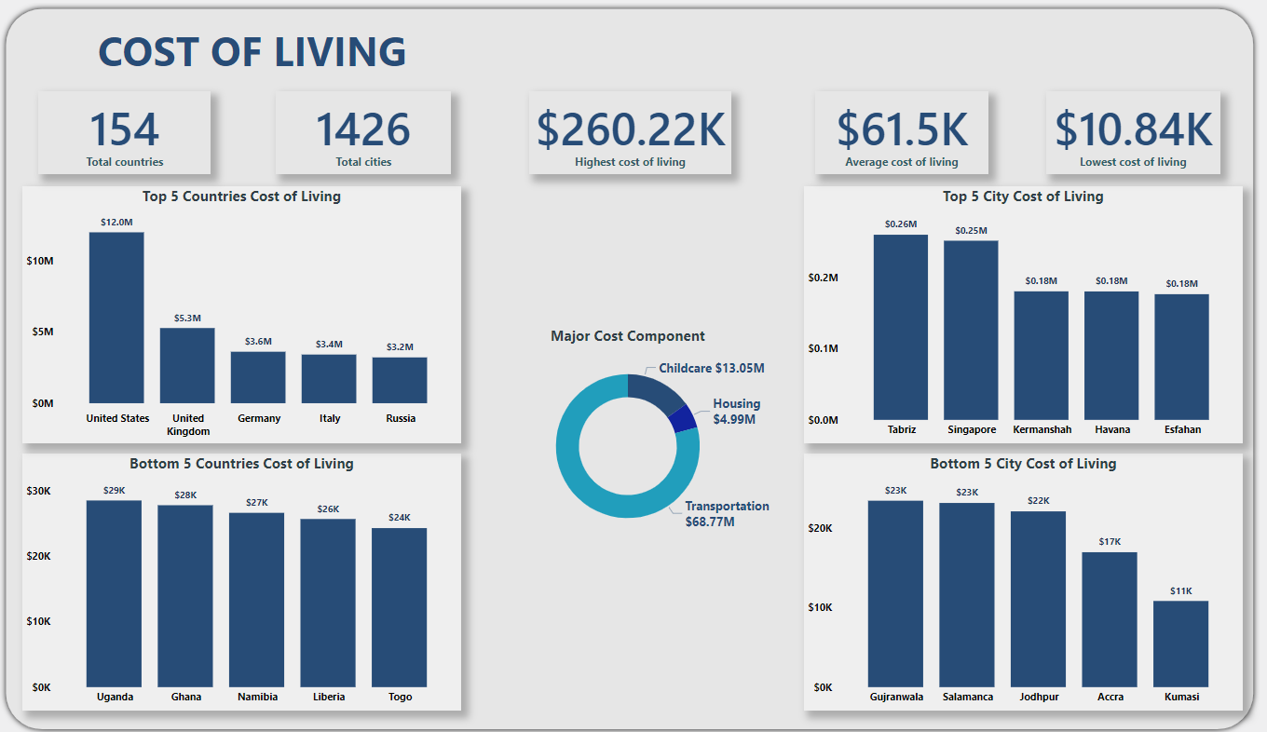
COST OF LIVING

Slide 6
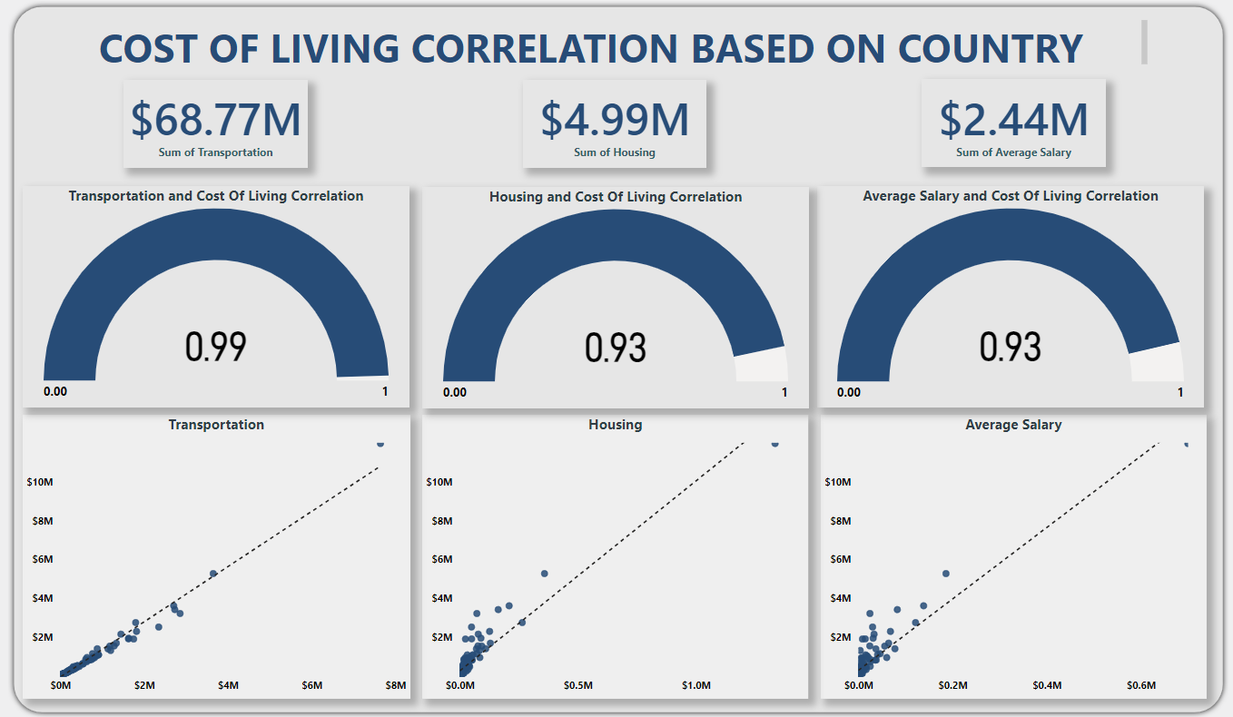
CORRELATION

Slide 7
The data set involves 154 countries and 1426 cities after cleaning the dataset.
The analysis reveals that, some countries have a high cost of living such as United States, United Kingdom, while countries like Togo and Liberia have the lowest cost of living. The average cost of living is $61.5k, the highest cost of living is $260.22k, while the lowest cost of living is $10.84k.
The three major components that contribute the cost of living is Transportation, Housing, and Childcare.
Understanding the variations in cost of living across different cities will make individuals to make choices and differentiate between wants and needs, about relocation, budgeting, and career opportunities.
INSIGHTS

Slide 8
THANK YOU

